Slide 1

MSE 311: Thermodynamics of Materials
Lecture 8: Most Probable Distribution
Weishu Liu
Department of Materials Science and Engineering
Southern University of Science and Technology (SUSTech)
Email: liuws@sustech.edu.cn
Office: North Tower, Rm310

Slide 2
Thermodynamics free energy
Thermodynamic free energy,
the energy in a physical system that can be converted to do work
Helmholtz Free Energy A, or F
----the energy that can be converted into work at a constant T and V
Gibbs Free Energy G,
----the energy that can be converted into work at a constant T and P
throughout the system

Slide 3
U,H, A, G
Internal energy
Helmholtz Free Energy
dU
-d(TS)
dA
+d(PV)
+d(PV)
dH
-d(TS)
dG
Enthalpy
Gibbs Free Energy

Slide 4
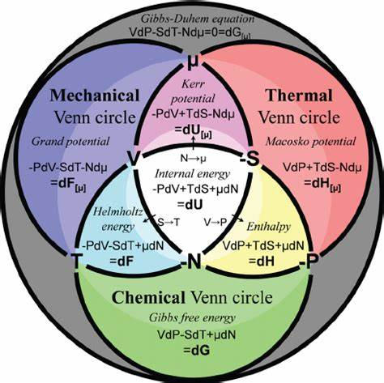
Thermodynamics Venn diagram
Grandcanonical Potential
Canonical Potential
American Journal of Physics 79, 950 (2011)

Slide 5
16. Boltzmann Equation
Chapter 4
Introduction of Thermodynamics, /6th Edition, CRC Press, 2018

Slide 6
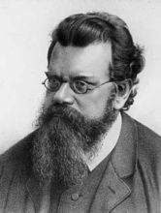
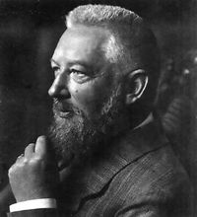
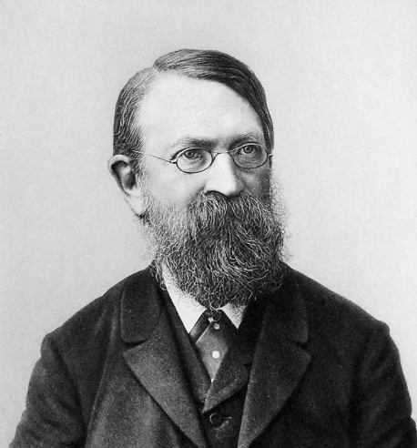
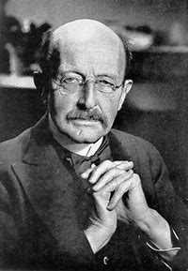
The Ostwald-Boltzmann Controversy
Noble Prize: 1909
Discover ring Nitric arcid
Friedrich Wilhelm Ostwald
Ludwig Boltzmann
1853-1932
1844-1906
What the world made by：
Energy VS Atom
Noble Prize: 1918
Ernst Mach
1838〜1916
Max Planck
1858-1933

Slide 8
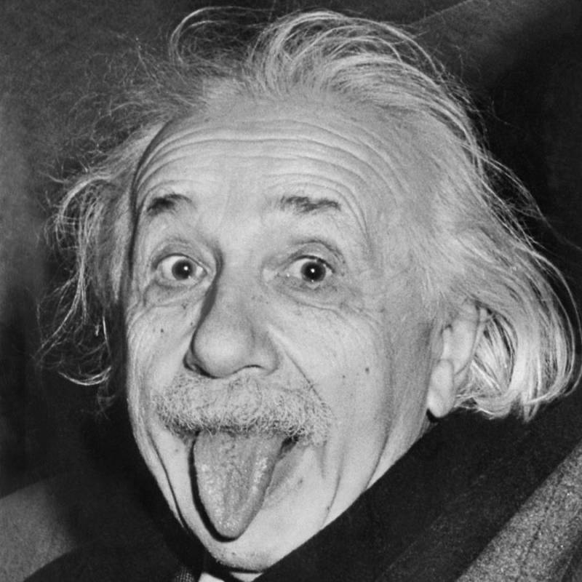
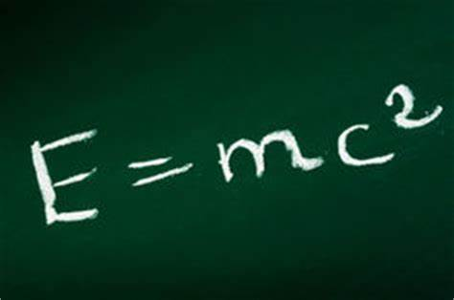

Slide 9
Scope of Statistic Thermodynamics
Classic Thermodynamics
Classic Thermodynamics is phenomenological.
TD variables: T, V, P
It didn’t consider the properties of their constituent particles and the interactions between them.
Statistic Thermodynamics
It consider the detailed information of the constituent particle by statistical methods, probability theory and the microscopic physical laws.
It provides a connection between the macroscopic properties of materials in thermodynamic equilibrium, and the microscopic behaviors and motions occurring inside the material.

Slide 10

Entropy: the degree of disordering
H₂O
Melting
Boiling
ΔS = ΔH_{melting}/T
ΔS = ΔH_{boiling}/T
Latent heat of melting
Latent heat of evaporation
Disorder increases, entropy increases

Slide 11
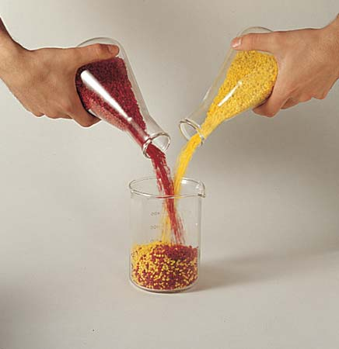
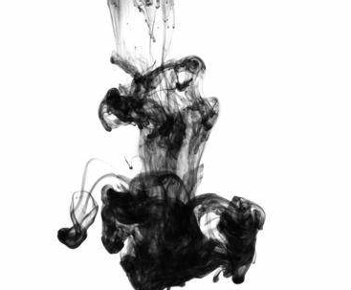
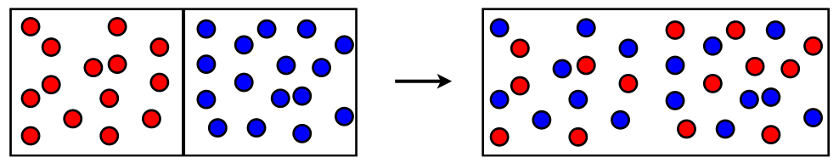
Degree of Mixed-up-ness
The mixing is a irreversible process
The mixed-up-ness describe the indeterminacy at a given location
How quantification of the term “degree of mixed-up-ness?

Slide 12

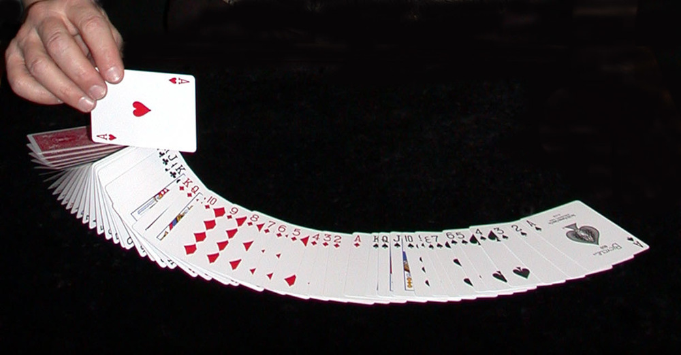

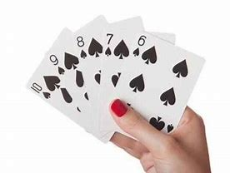
Macrostates & Microstates
Microstates
Pick up any 5 card
Macrostate, i.e. flush
Straight flush
Macrostate, i.e. Straight flush

Slide 13
Physics of wave
Quantized energy level
Wave is the propagation of a vibrational state, in which energy is transported without simultaneous mass transport.

Slide 14
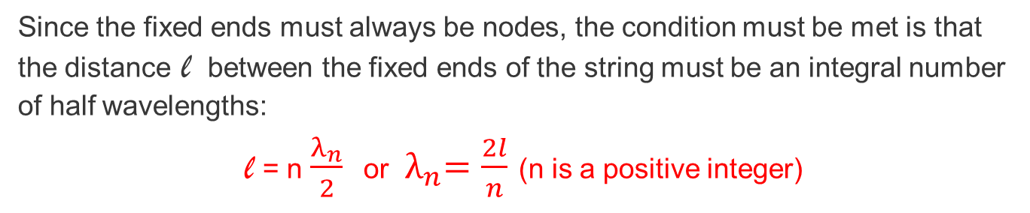
Standing wave in a string with two ends fixed
Since the fixed ends must always be nodes, the condition must be met is that the distance l between the fixed ends of the string must be an integral number of half wavelengths:
l = n $\frac{λ_{n}}{2}$ or ${ λ}_{n}=\frac{2l}{n}$ (n is a positive integer)

Slide 15
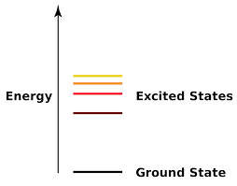
,
Quantized energy level
,
,
In Quantum theory
If a particle is confined to move within a given fixed volume, then its energy is quantized, i.e., the particle may only have certain discrete allowed values of energy, which are separated by “forbidden energy bands.”
Quantized energy level of the particles or the crystal structure is
The ground state : ε₀
The succeeding levels of increasing energy: ε₁ , ε₂ , ε₃

Slide 16
Quantized energy level
For the crystal contains n particles and has the energy U
statistical mechanics asks the questions:
In how many ways can the n particles be distributed over the available energy levels such that the total energy of the crystal is U, and, of the possible distributions, which is the most probable?

Slide 17
Most Probable Distribution
Let’s say we have three identical particles, which are located on three distinguishable lattice sites A, B and C.
Let’s say the energy levels are equally spaced, with the ground level being taken as zero, the first level ε₁ = u, the second level ε₂ = 2u and the ε3 = 3u. Let the total energy of the system be U = 3u
Three macrostates
ε₃
ε₂
ε₁
ε₀
(a)
(b)
(c)

Slide 18
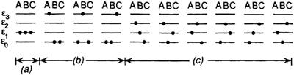
Most Probable Distribution
Consider three distinguishable lattice sites A, B and C.
All three particles in level 1:
1 combinations
b. One particle in level 3, and the other two particles in level 0:
3 combinations
c. One particle in level 2, one particle in level 1, and one particle in level 0:
3 x 2 x 1 = 3! = 6 combinations

Slide 19
Most Probable Distribution
These distinguishable arrangements are called complexions or microstates,
and all of the 10 microstates correspond to a single macrostate.
Microstate: knowing properties of all particles
Macrostate: knowing properties of the system

Slide 20
Most Probable Distribution
Let’s say we have a system of volume V, internal energy, U and temperature T, consists of n particles.
The particles can be atoms, molecules, which are structurally identical.
These particles are distributed in i energy levels (quantum theory)
Combinatorics
Energy level
e₀
e₁
e₂
……..
e_{i}
Distribution 1
Distribution 2
# of particles
n₀
n₁
n₂
……..
n_{i}
# of particles
n’₀
n’₁
n’₂
……..
n’_{i}
∑n_{i} = n, and ∑e_{i}n_{i} = U
The number of combinations:
The number of total combination:

Slide 21
Most Probable Distribution
The earlier example:
The number of arrangement

Slide 22
Find Most Probable Distribution
Find Most Probable Distribution
=Find set of n_{i}, to maximize Ω_{i} = n!/(n₁!n₂!..n_{i}!)
Any interchange of particles
Stirling’s approximation: when X is very large: ln(X!) ≈ XlnX -X
n is constant → δnlnn=0
If Ω has the maximum possible value then a small rearrangement of particles among the energy levels will not alter the value of Ω or of ln Ω

Slide 23
Find Most Probable Distribution
β is the constant with the units of reciprocal energy
Α is the dimensionless constant
Partition function

Slide 24
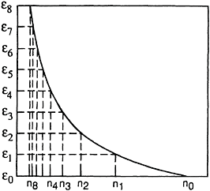
Boltzmann’s distribution function
Boltzmann’s distribution function
k_{B} is the Boltzmann constant
Schematic representation of the most probable distribution of particles among the quantized energy levels.

Slide 25
Most Probable Distribution
One distribution have most probable arrangements, t
N << t, lnN << lnt: lnΩ ≈ lnt
So, we can use the most probable distribution to
describe the system, and neglect other distribution.

Slide 26
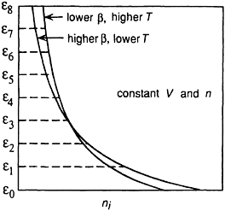
Temperature Effect
Schematic representation of the most probable distribution of particles among the quantized energy levels.
Influence of temperature on the most probable distribution of particles among energy levels

Slide 27
Internal energy increase with temperature
set of n_{i} maximizes Ω_{i} = n!/(n₁!n₂!..n_{i}!)
as the n_{i} follow the Boltzmann temperature
Higher temperature, higher energy levels become more populated, so the U increases

Slide 28

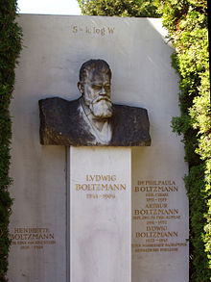
Boltzmann Equation
The system of n particles and heat bath with fixed U, V and n are in thermal equilibrium
Now let small amount of heat flow to the system, the Ω will change:
δq = dU, constant volume:
dS = δq/T
Boltzmann
equation
Entropy: S
Ludwig Boltzmann
Number of arrangement: Ω
1844-1906

Slide 29
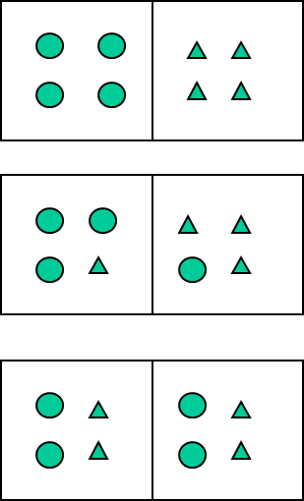

Configurational Entropy
Two crystal contact
Ω_{4:0} = 1
Ω_{1:3} = 16
Ω_{2:2} = 36
(Ω_{3:1} = 16)
(Ω_{0:4} = 1)

Slide 30
Configurational Entropy
A + B (unmixed) → A + B (mixed) at constant U, V and n
(state 1) (state 2)
Total mix
Before mix

Slide 31
Configurational and thermal Entropy
Entropy is a measure of the randomness of a thermodynamic system. An increase in the randomness refers to the increase of the entropy and vice versa
Thermal entropy
or vibration entropy
Configurational
Entropy
Configurational entropy refers to the work done without an exchange in temperature,
Thermal entropy refers to the work done with the exchange in temperature.

Slide 32
Configurational and thermal Entropy
Entropy is a measure of the randomness of a thermodynamic system. An increase in the randomness refers to the increase of the entropy and vice versa
Thermal entropy
or vibration entropy
Configurational
Entropy
Configurational entropy refers to the work done without an exchange in temperature,
Thermal entropy refers to the work done with the exchange in temperature.

Slide 33
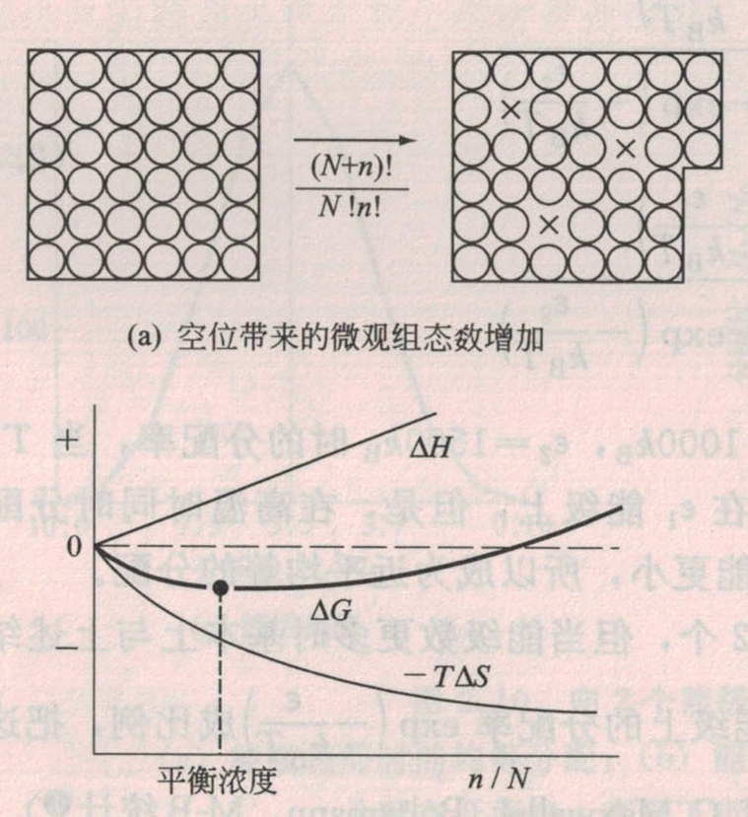
The vacancy concentration ?
Considering the formation energy of a vacancy: ε_{V}
The increase entropy equivalent to arrange N atoms and n vacancies on N+n lattice site:

Slide 34
17. Elastocoloric/ Electrocaloric/Magnetocaloric

Slide 35
A simple example
Wang et al., Science 366, 216–221 (2019)

Slide 36
Fig. 1. Twist-based mechanocaloric performance for single rubber fibers.

Slide 37

Elasto-coloric effect in polymer
Rapid stretching or unstretching of a wide rubber band is nearly isentropic/ adiabatic process
The stretching decreases the configurational entropy S_{conf} (molecular structure becomes more ordered)
the stretching is isentropic, then the thermal/vibrational entropy S_{th} increase to compensate for the decrease of S_{conf}.
the heat generated by stretching is dissipated
T should decrease as a result of rapid unstretching

Slide 38
Elasto-caloric effect in polymer
Elastocaloric - uniaxial stress
Barocaloric - hydrostatic P
Magnetocaloric - magnetic field
Electrocaloric - electric field
European Polymer Journal , 2018, 99, 212–221

Slide 39
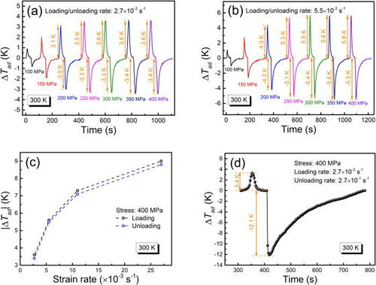
Elastocoloric Effect in metals
Large elastocaloric effect in a Heusler-type Co₅₀V₃₅Ga₁₄Ni₁ polycrystalline alloy
Appl. Phys. Lett. 118, 103904 (2021)

Slide 40

Theoretically Considering Elastocaloric Effect
Helmholtz Free energy is chosen for the TD criteria
$$A=U−TS$$
Applied Thermal Engineering 57 (2013) 33-38

Slide 41

Helmholtz Free energy
the evolution of the temperature exchangebetween natural rubber and the ambient environment as a functionof the mechanical elongation.
$$A=U−TS$$
Assuming that the heat transfer between the material and the ambient temperature
h: heat coefficient, Λ:surface, T_{ext} : room temperature
Maxwell relation：
Applied Thermal Engineering 57 (2013) 33-38

Slide 42
Refrigerant capability (RC)
Applied Thermal Engineering 57 (2013) 33-38

